Slide 1
Country Report MONGOLIA
Participants; Batsaikhan KHOROLSUREN
Erkhembayar BATBAYAR

Slide 2
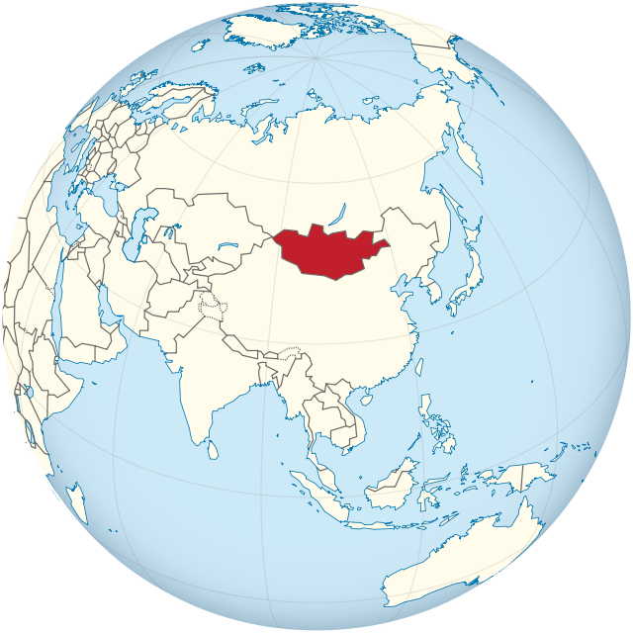
About Mongolia
neighbors: Russian federation and Popular republic of China
Territory: 1.5 million Square km
Population: 3 million and 1.2 million is labour force
Unemployment rate: 6.4%

Slide 4
THE GOVERNMENT POLICY AND REFORM ON OCCUPATIONAL SAFETY AND HEALTH OF MONGOLIA
GASI

Slide 5
Content
BACKGROUND FOR MONGOLIA, MINISTRY OF LABOUR AND SOCIAL PROTECTION AND THE GENERAL AGENCY for SPECIALIZED INSPECTION
1
POLICY, Legislative environment, foreign cooperation
2
3
Industrial accidents
4
Preventive measures
5
The future measures and prospects

Slide 6
The KEY objectives of GASI
Our objectives are:
To arrange implementation of the Specialized Inspection related laws and regulations, supervision policy planned on the strategic management
To enable conditions to live and work in safe and healthy environment and to consume safe and quality products and services
To create a healthy environment for business and organizations to operate for sustainable human and social development

Slide 7
main goals of Activities
Goal 1. Reform the mechanism of specialized inspection and change the organizational structure;
Goal 2. Develop a risk management system and build its capacity through trainings, surveys, researches, and technical services for risk management;
Goal 3. Improve the responsibility and accountability of the agency;
Goal 4. Improve the internal organizational management within the inspections agencies and support the operation of state inspection units;

Slide 8
Risk high sectors;
Mining
Construction
Road construction
Electricity /Power plant/
Must have at least one or more full-time officer/s in charge of OSH regardless of the size of enterprises in case of high risk enterprises such as those in mining, electricity, road and construction sectors

Slide 9
Industrial accident and acute poisoning /2016 statistic information/ In 2016 , 332 industrial accident occurred, decreased by 13 percent

Slide 10
Policy, legislative environment and INTERNATIONAL cooperation

Slide 11
Mongolian National OSH law in brief
a) Establishing an OSH Council for all enterprises/ organisations employing more than 20 workers;
b) Having at least one or more full-time officer/s in charge of OSH in case of enterprises employing 50 to 100 workers, and establishing a structure (unit) in charge of OSH in case of enterprises employing more than 100 workers;
c) Having at least one or more full-time officer/s in charge of OSH regardless of the size of enterprises in case of high risk enterprises such as those in mining, electricity, road and construction sectors;
d) Assigning an OSH function to appropriate full-time staff in case of public administration and public service organisations;
e) Outsourcing OSH services to specialised OSH service providers or OSH specialists in case of enterprises and organisations employing less than 50 workers;
f) Allocating funding for OSH actions at least at the level prescribed by law;
g) Ensuring to undertake an assessment of working conditions by authorised organisations6 ;
h) Undertaking risk assessment for the purpose of identifying, determining, assessing, reducing and eliminating workplace hazards;

Slide 12
i) Establishing management responsibility for implementation of OSH laws, regulations, applicable standards, and recommendations from the assessment of working conditions; and
1) Establishing a Commission for Investigating and Reporting Industrial Accident and Acute Poisoning which is required to work on a regular basis and which shall consists of at least three persons, including representatives of employers and workers of the given enterprise7;
The OSH law also requires that a general contractor (for instance in construction of buildings) shall be responsible for concluding agreement with their sub-contractors to comply with national OSH requirements and standards; in case of absence of such agreement, the general contractor would be held responsible for ensuring occupational safety and health, and payment of injury compensation and other financial obligations prescribed by law. According to the Company Tax Law, expenditures for safety and health of workers are deducted from taxable income.

Slide 13
The Government policy and main principles on occupational safety and health
The fundamental concept of occupational safety and health policy is to take all necessary actions for protecting lives and health of workers.
OSH
Enforce unified standards and norms for OSH in Mongolia
Provide permanent inspection on OSH to ensure the proper compliance to standards
Ensure transparent and accountable information
Create workplaces according to OSH standards

Slide 14
Legislative environment
The law on OSH was adopted in 2008 /Modified in 2015/
64 regulations
140 standards
The 5th National Program on improving OSH has been implemented since this year
In those years 2006 and 2009, the International Labour Organization's audit certified that a proper legislative environment on preventive measures has been created in Mongolia

Slide 15
Objectives of THE national programme
To improve the legislative environment and standards on OSH and ensure their implementation
To create risk-free, safe and healthy workplaces
To encourage workers to maintain safe behavior and culture in workplaces
To ensure the rights of workers to work in a safe environment by improving national management and the capacity of OSH
To decrease the level of occupational accidents and work-related illnesses

Slide 16
Objectives of national program
To upgrade standards and regulations on OSH in accordance with international standards, norms, and national special circumstances;
To ensure the implementation of regulations and standards in workplaces and business entities;
To strengthen preventive measures on occupational accidents and work-related illnesses;
To take measures to prevent against illness and disorders due to mercury, asbestos and reduce and stop the usage of chemical substances;
To improve compensation services to workers who are affected by work-related illnesses and accidents;
To develop a public monitoring and inspection system;
To enhance training, research and awareness activities in OSH and improve the national capacity of OSH management;

Slide 17
Amended provisions for the law on osh / issues
To clarify roles and responsibilities of employees who are in charge of OSH measures
To increase the minimum budget of employers dedicated to OSH measures
To strengthen the legal penalty for noncompliance with safety measures
To ensure proper management of OSH
To organize risk evaluation measures in collaboration with OSH committee and trade unions

Slide 18
International cooperation on Osh
Member of International Labour Organization since 1968
GIZ
internationalcooperation
Authority for Labour and Social Security of Russian Federation /GASI/
КOSHA
JICA

Slide 19
МОНГОЛ УЛС ОУХБ-ЫН 16 КОНВЕНЦИД НЭГДЭН ОРСОН:
16 conventions that Mongolia affiliated
N | Name of Conventions | Number | Year of ratification
1 | Minimum Age (Industry) Convention | 59 | 1969
2 | Freedom of Association and Protection of the Right to Organise Convention | 87 | 1969
3 | Right to Organise and Collective Bargaining Convention | 98 | 1969
4 | Equal Remuneration Convention | 100 | 1969
5 | Maternity Protection Convention | 103 | 1969
6 | Discrimination (Employment and Occupation) Convention | 111 | 1969
7 | Employment Policy Convention | 122 | 1976
8 | Minimum Age (Underground Work) Convention | 123 | 1981
9 | Vocational Rehabilitation and Employment (Disabled Persons) Convention | 159 | 1983
10 | Workers' Representatives Convention | 135 | 1996
11 | Tripartite Consultation (International Labour Standards) Convention | 144 | 1998
12 | Occupational Safety and Health Convention | 155 | 1998
13 | Worst Forms of Child Labour Convention | 182 | 2001
14 | Minimum Age Convention | 138 | 2002
15 | Forced Labour Convention | 29 | 2005
16 | Abolition of Forced Labour Convention | 105 | 2005

Slide 20
The current situation of occupational accidents

Slide 21
2010-2014 OCCUPATIONAL ACCIDENTS on FIELDS

Slide 24
Table 1 & 2: Occupational accidents by various factors and sectors, Mongolia Mongolia: Occupational accidents 2010-2016 (Source: GASI, March 2017)
Years
2010 2011 2012 2013 2014 2015 2016
Number of accidens 366 403 400 406 333 383 332
Of which, number of group accidents 15 15 14 12 17 17 11
Victims Total 398 431 424 425 363 404 332
From which, females 92 112 111 171 114 118 115
Deaths 80 75 87 51 56 48 31
Permonantly disabled 44 40 35 210 26 25 159
Temporarily disabled 273 310 301 164 283 325 142
Changed a job 1 6 1 6
Forms Caused deaths 80 75 87 51 56 48 31
Serious injuries 141 142 165 210 186 209 159
Light injuries 177 214 172 164 119 147 142
Age Below 18 years 0 2 3 1 1 2 3
18-35 years 206 224 235 198 182 206 155
Above 35 years 192 205 186 226 180 196 174
Work experience below 5 years 155 183 187 165 156 166 56
5-15 years 127 107 126 136 88 126 192
more than 15 years 116 141 111 124 120 112 84
Reasons Falls and slides 112 101 102 74 63 79 46
Breakdown of vehicles 36 56 30 83 56 57 51
Breakdown of lifting equipment 5 4 15 12 10 11 6
Breakdown of equipments 32 15 14 20 37 29 44
Violation of technological process 34 24 28 12 14 8 6
Non-adherence to safety regulations 75 64 70 44 49 56 54
Personal protective gear 8 20 4 7 6 6 3
Others 96 147 161 173 98 137 122

Slide 25
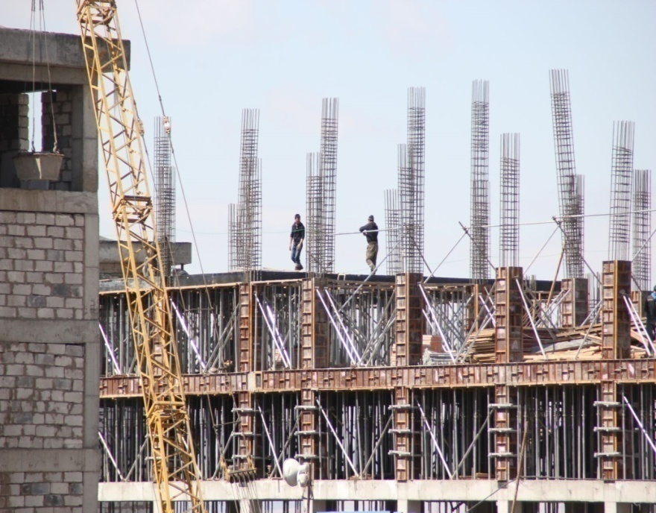
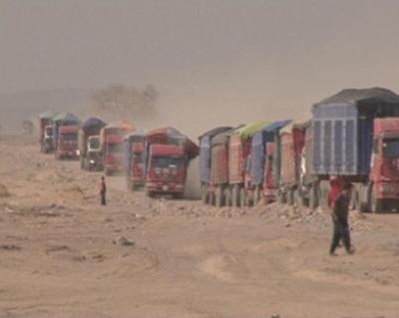
өнөөгийн байдал
current situation
MINING, CONSTRUCTION, road AND ENERGY SECTORS have had the highest rate of occupational ACCIDENTS in recent years
During 2010-2014, the number of fatalitIES wERE 349 and the number of disabled people was 355
83940.5 million tugrugs was spent ON compensation from the insurance fund for Occupational accidentS and work-related disorders

Slide 26
Main causes of occupational accidents
Lack of safety culture and behavior among workers
Limited knowledge and experience to enforce OSH laws and regulations
Employers' budget for OSH is less than the legal minimum requirement
Lack of employees specialized in OSH in private entities
Noncompliance and ignorance in construction companies of safety rules and norms

Slide 27
Preventive measures

Slide 28
Preventive measures
Accident prevention is not only an issue of the government; therefore, organizing a “SAFETY FIRST” conference in collaboration with non-government organizations and private entities to discuss issues and necessary responses is crucial.
Taking Risk based inspections by the agency
amending the law and regulations in osh and revising methods of risk evaluation by investigating occupational accidents.

Slide 29
Reform on occupational inspection for prevention
In order to improve the preventive capacity, the Deputy Prime Minister of Mongolia and Minister of Labour have made a decree on “Reforming occupational inspection”. The following aspects have been prioritized.
1. PREVENTION
2. REALISTIC EVALUATION OF CONDITIONS AND RESPONSE
3. RESULT (RISK) BASED INSPECTION
4. TRANSPARENCY
5. EQUITY

Slide 30
Future measures and prospects

Slide 31
Future measures and prospects
We Plan to work on the following key objectives:
To clearly set roles and responsibilities of employees who are in charge of occupational safety
To enhance the responsibilities of employers and employees
To increase the involvement of local government administrative agencies in OSH
To allocate more budget for prevention rather than post –accident activities
To make necessary changes on OSH standards
To develop a database for occupational accident statistics
To improve the occupational accident insurance system
To strengthen the human capacity building system for OSH
To maintain safety culture and behavior

Slide 32
Thanks for your attention!

